Slide 1
A1. Petroleum generation modeling
Alina Khayrullina
Daniil Sherki
Evgeny Serebrennikov
Timur Zakarin

Slide 2
Week 1

Slide 3
1. Using the law of mass action write down the system of kinetic differential equations.
2. Rewrite the system of differential equations in the form 𝑥̇=𝐴𝑥, where 𝑥̇ denotes the derivative in time.
3. How can you describe the matrix A? How can you solve such matrix equation?
4. Find eigenvalues of matrix A. Describe in details the procedure how to find the analytical solution.

Slide 4
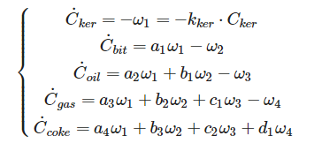
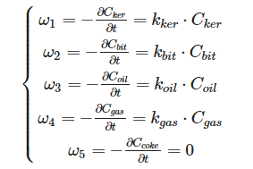
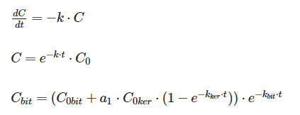
Subtask 1
According to law of mass action, velocity of decomposition reaction equal ω=kC^{n}_{ker} , when ω - velocity of the reaction, k - constant of velocity reaction, n - reaction order It is a decomposition equation, that means the order of the reaction will be equal to 1.
Therefore, velocity of decomposition reaction for every component equal
In the next step, we need to find velocity of formation reaction every component

Slide 5
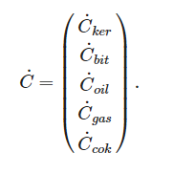
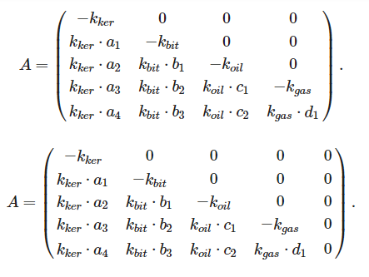
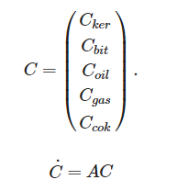

Subtask 2

Slide 6

Subtask 3
Matrix A is a square matrix of size 5x5. The type of the matrix - triangular. The matrix equation can be solved with the following methods:
Kramer's method
Reverse matrix method
Gausse's method

Slide 7
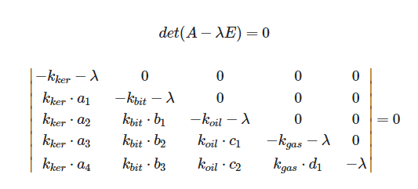
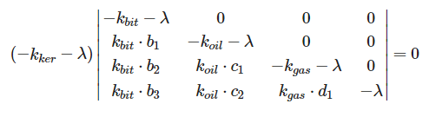
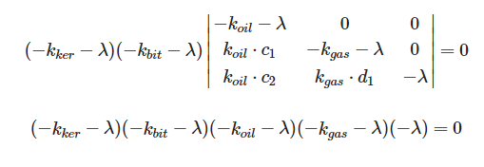
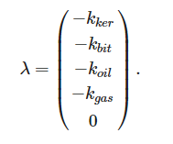
Subtask 4

Slide 8
Week 2

Slide 9
Tasks for Week 2
Perform numerical integration of the differential equation system using Matlab or Python. Use Arrhenius law and take A1 = A2 = A3 = 10^14 s^-1, E1a = 200 kJmole, E2a = 220 kJmole, E3a = 240 kJmole, E4a = 260 kJmole.
Consider the following molar masses:
Mkergoen = 2000 gmole, Mbitumen = 700 gmole, Moil = 350 gmole, Mgas = 58.6 gmole, Mcoke = 13 gmole.
Stoichiometry coefficients:
a1 = 1.46; a2 = 0.97; a3 = 2.16; a4 = 39.18;
b1 = 1.37; b2 = 0.76; b3 = 13.54;
c1 = 2.9; c2 = 13.84;
d1 = 4.51.
Consider two different temperature conditions: T1 = 350°C, T2 = 100°C . How do the results change?
How does +/- 5% alteration of each activation energy influence the results? Provide the graphs.

Slide 10
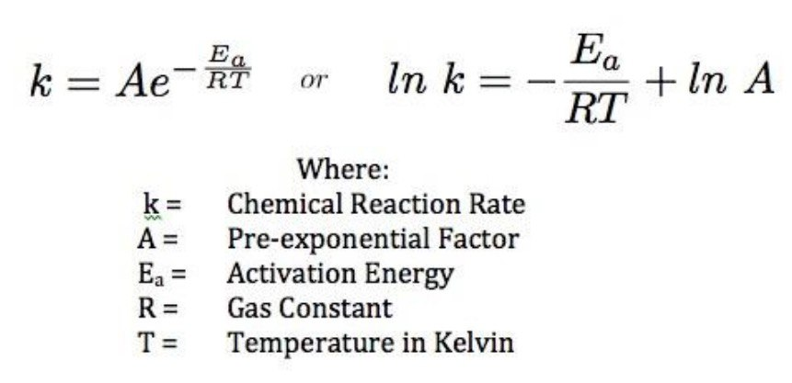
Task 1. Arrhenius law’s formula
We used Arrhenius law to find the rate constant k for each reaction

Slide 11
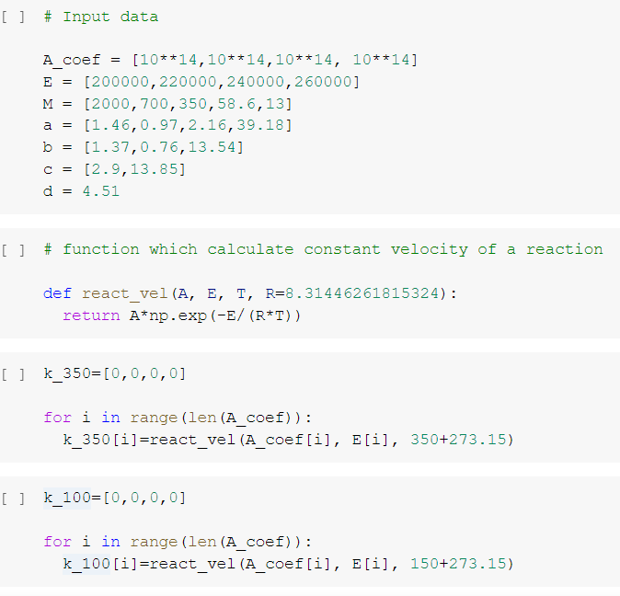
Task 1. Rate constants for T = 350 ℃ and T = 100 ℃
The calculations were performed in “Collab” using Python

Slide 12
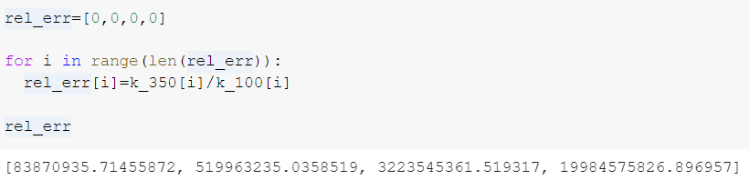
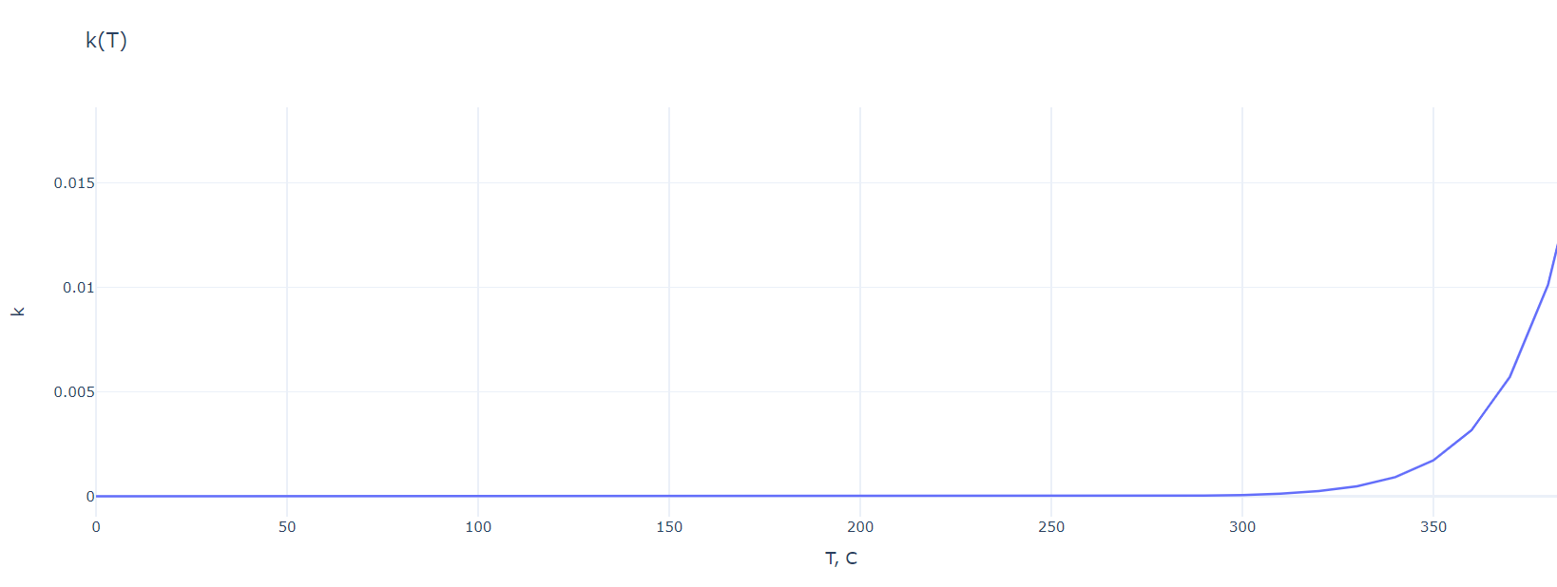
Task 1. Comparing rate constants

Slide 13

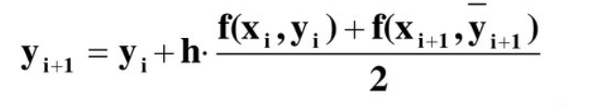
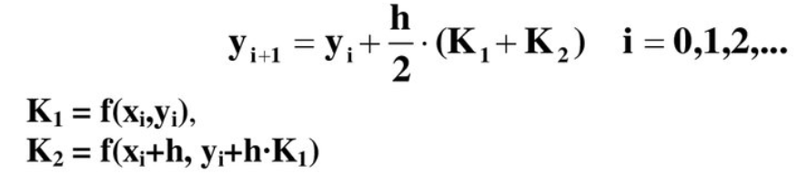
Task 1. Solving the differential equation system. Range-Kutt’s method
We applied second-order Runge-Kutta’s method to solve the system of differential equation

Slide 14
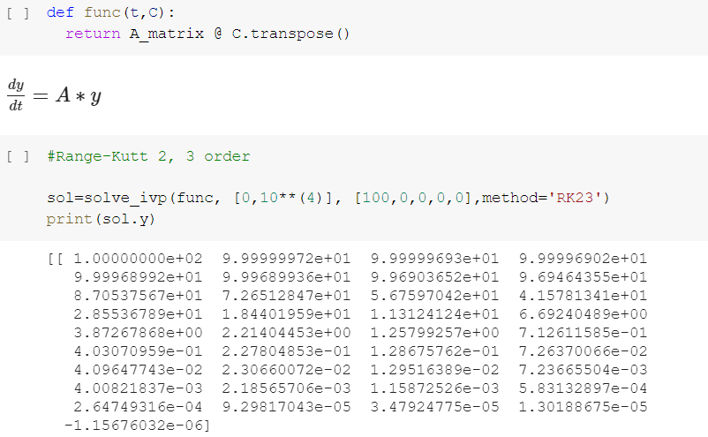
Task 1. Solving the differential equation system. Range-Kutt’s method
There’s a special function in Python which solves equation using second-order Runge-Kutta’s method

Slide 15
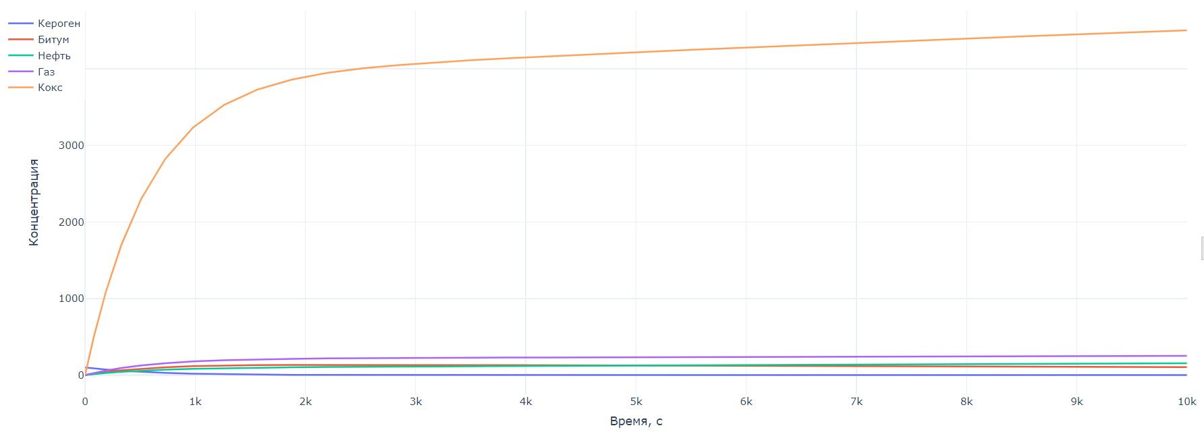
Task 1. Graph of changes in the mass of components over time (for T = 350 ℃)

Slide 16
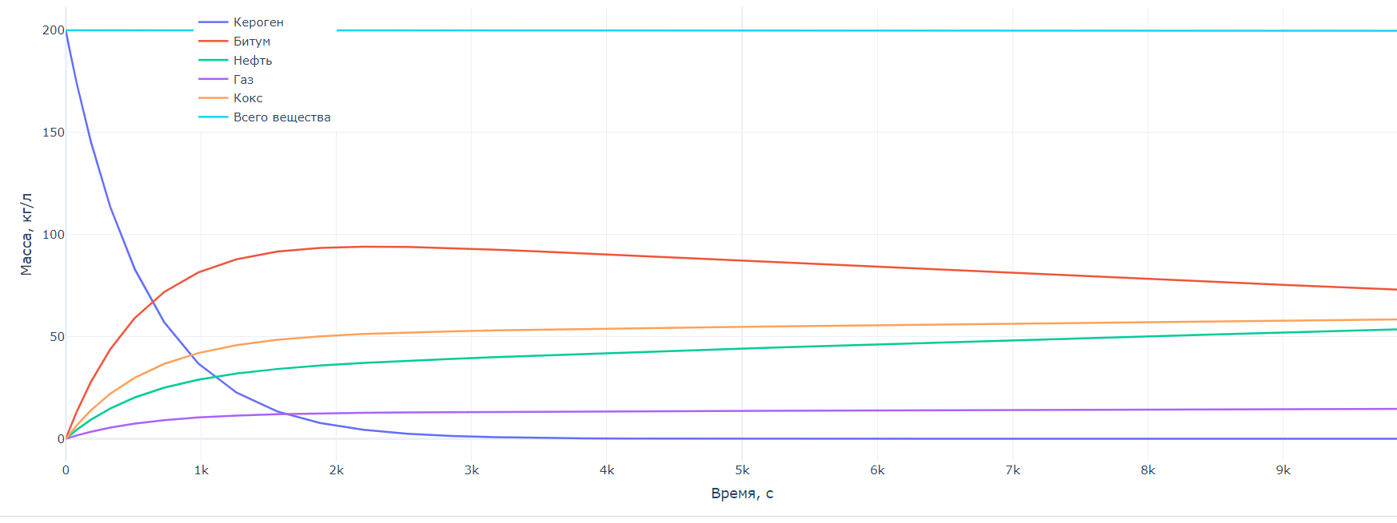
Task 1. Graph of changes in the mass of components over time (for T = 350 ℃)

Slide 17
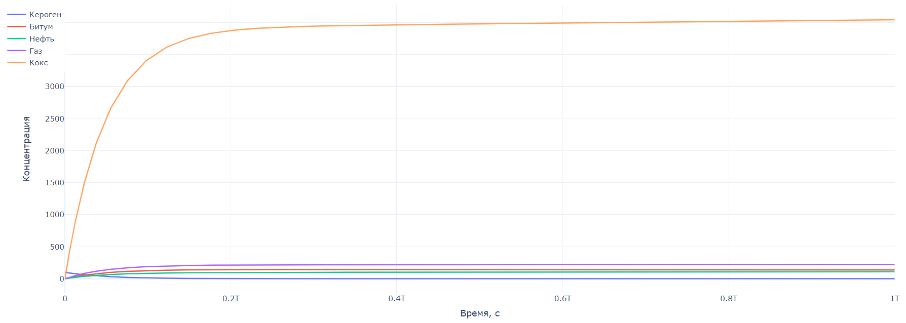
Task 1. Graph of changes in the mass of components over time (for T = 100 ℃)

Slide 18
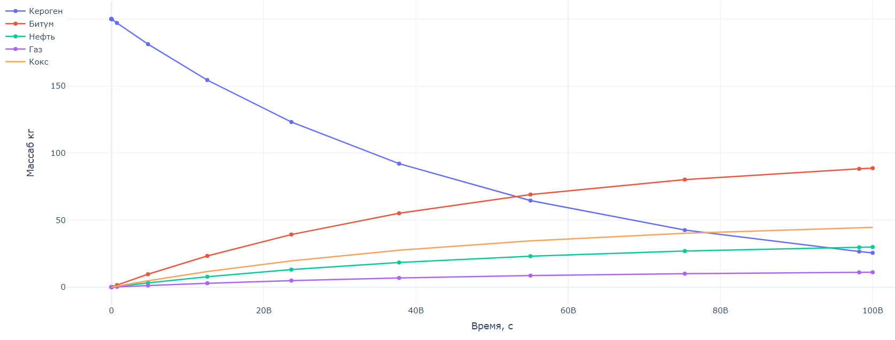
Task 1. Graph of changes in the mass of components over time (for T = 100 ℃)

Slide 19
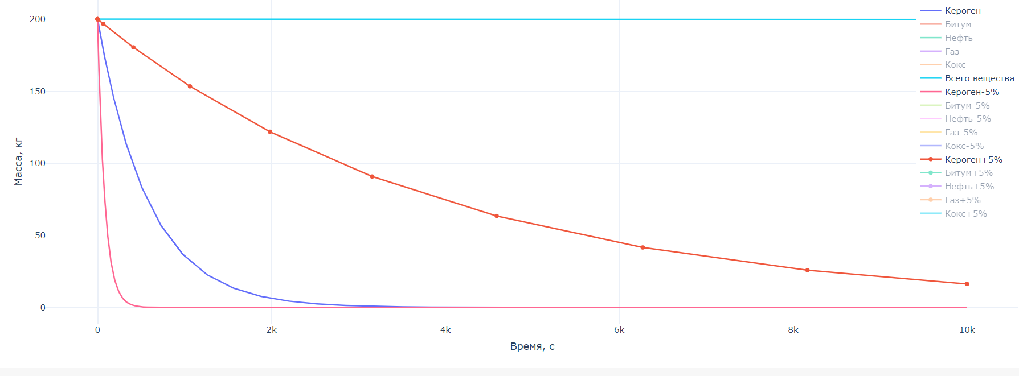
Task 2. How +/- 5% alteration of activation energy influence the final results

Slide 20
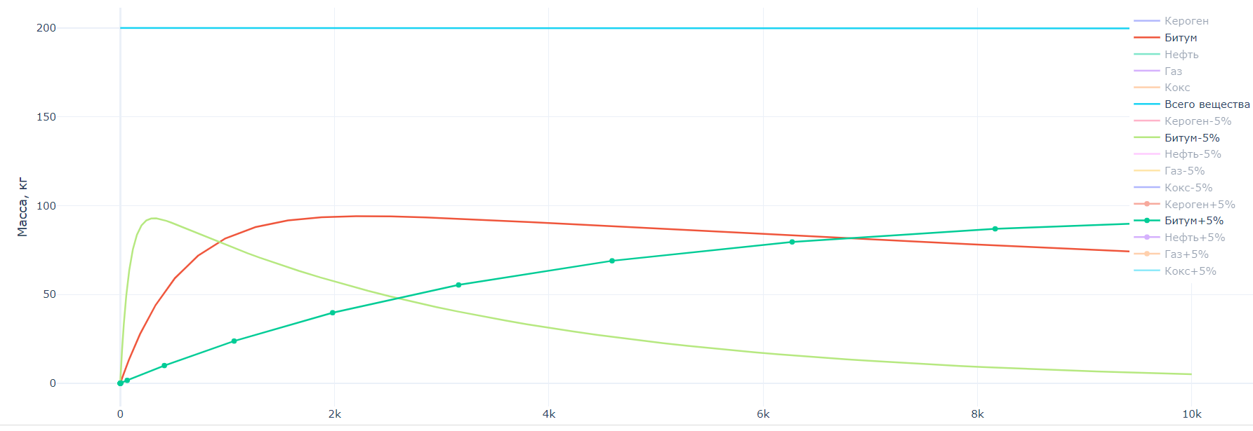
Task 2. How +/- 5% alteration of activation energy influence the final results

Slide 21
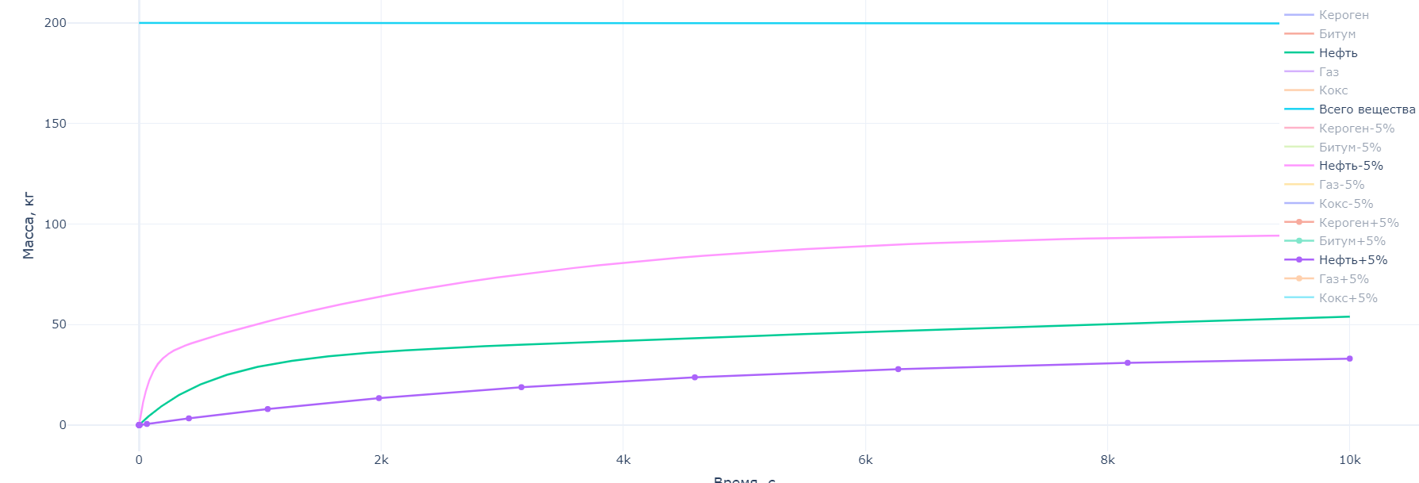
Task 2. How +/- 5% alteration of activation energy influence the final results

Slide 22
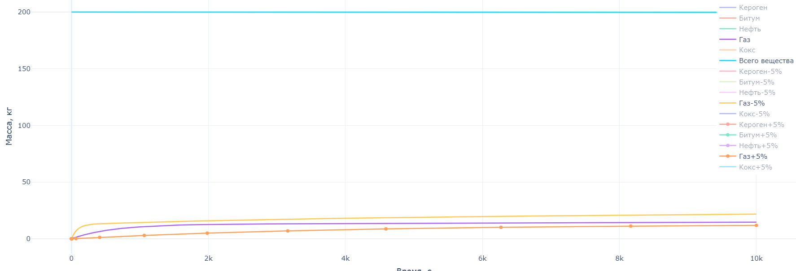
Task 2. How +/- 5% alteration of activation energy influence the final results

Slide 23
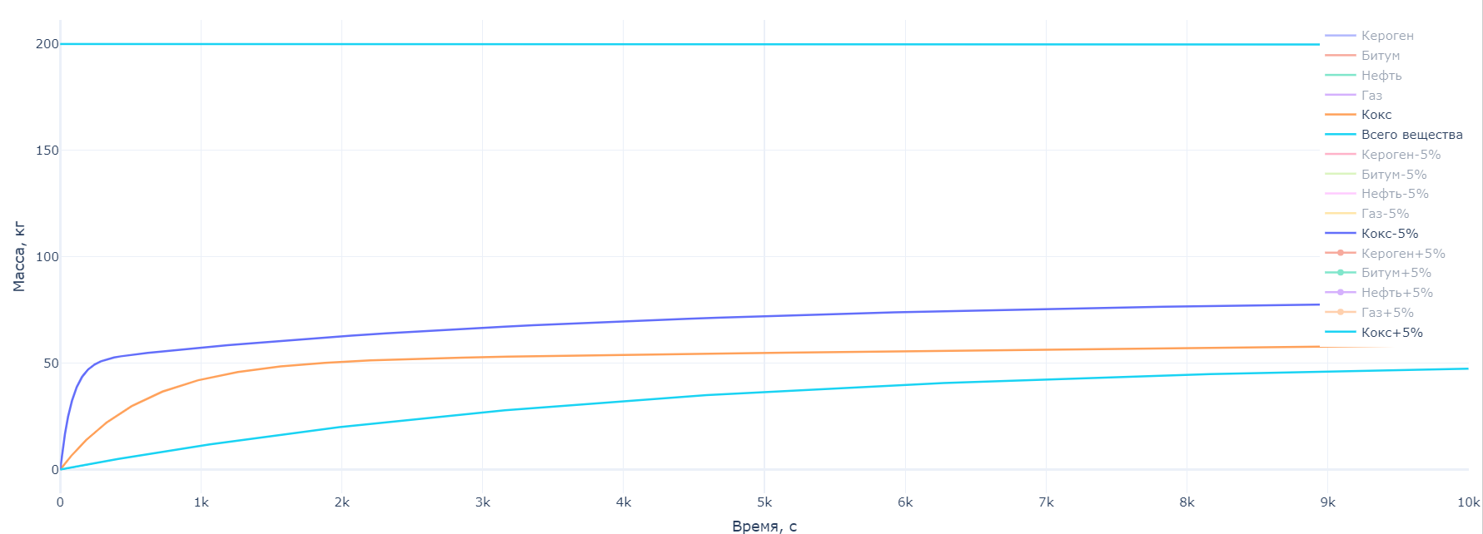
Task 2. How +/- 5% alteration of activation energy influence the final results

Slide 24
Week 3

Slide 25
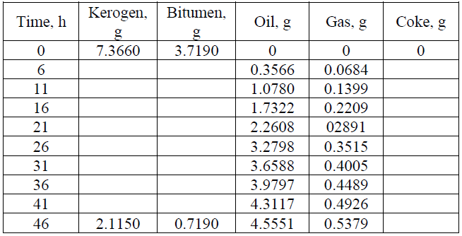
Tasks for Week 2
Using the equations, obtained in Week 1 task, derive analytical solution for isothermal (𝑑𝑇/𝑑𝑡=𝑐𝑜𝑛𝑠𝑡) transformation of kerogen and other products.
Using values, proposed in Week 2 task, plot analytical solution for several time points. Compare with numerical solution, obtained for Week 2 task.
Use values, proposed in Week 2 task, as an initial guess and try to provide nonlinear curve fitting for the following data from the real experiment: a) fix frequency factor (𝐴 = 10^14 𝑠−1) and temperature (𝑇 = 350 ℃), and then try to find optimal activation energies; b) Fix activation energies (take values from Week 2 task) and try to find optimal temperature and frequency factor.
Data for fitting:

Slide 26
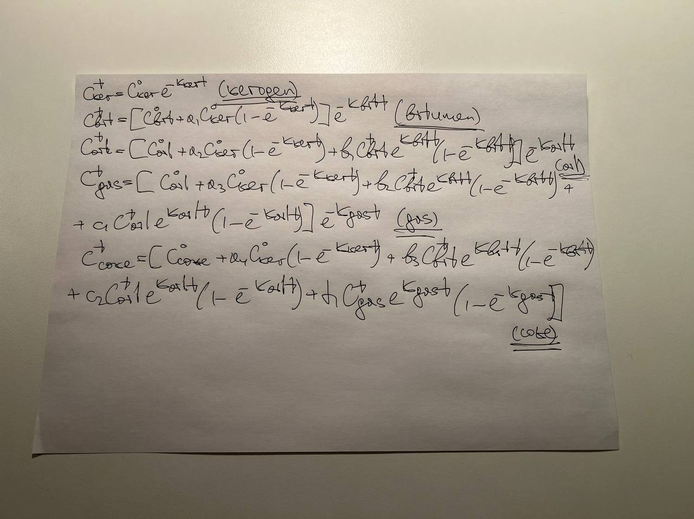
Task 1. Analytical solution for isothermal transformation of products

Slide 27
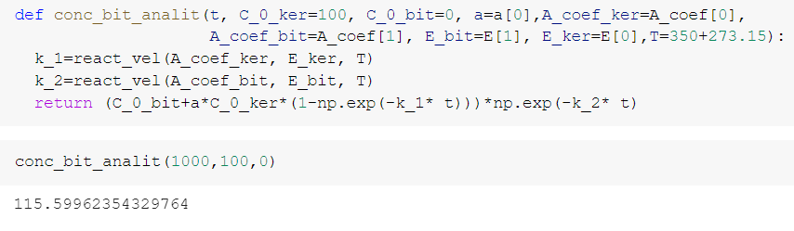
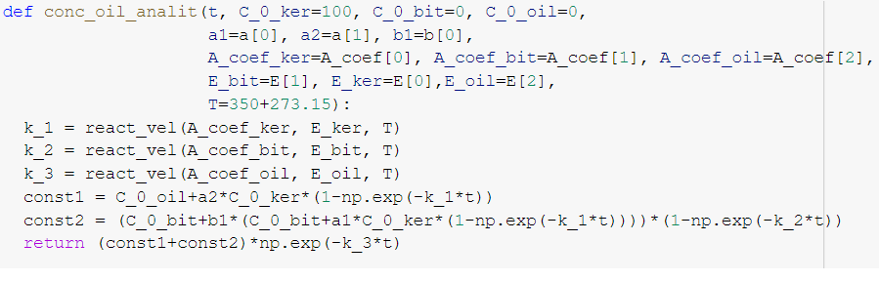
Task 1. Analytical solution for isothermal transformation of products

Slide 28
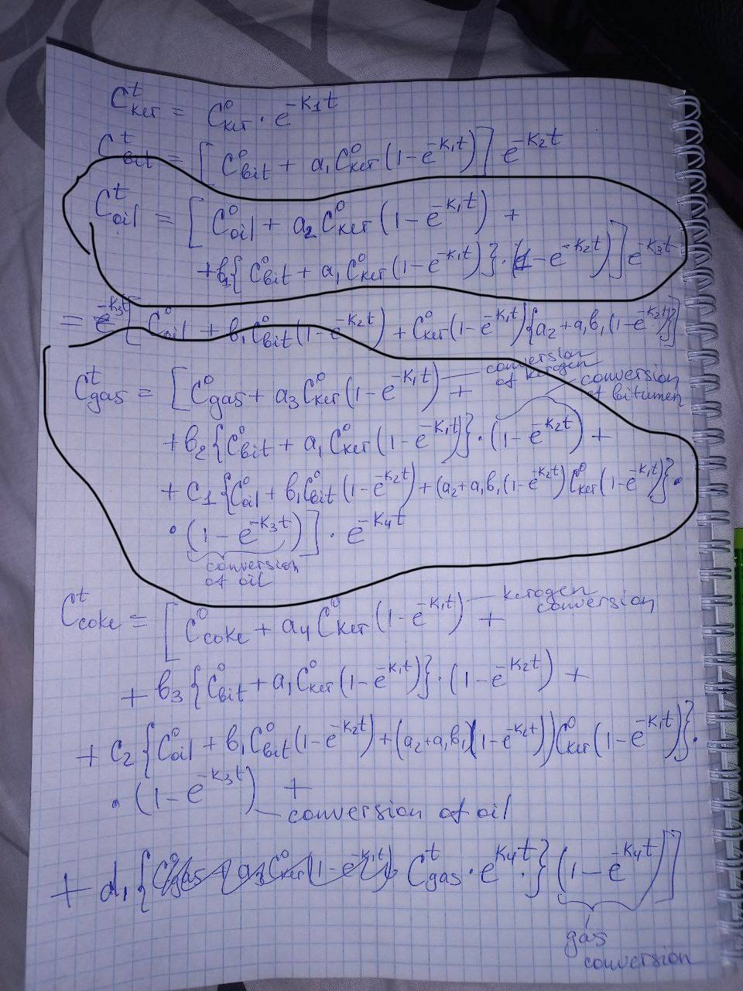
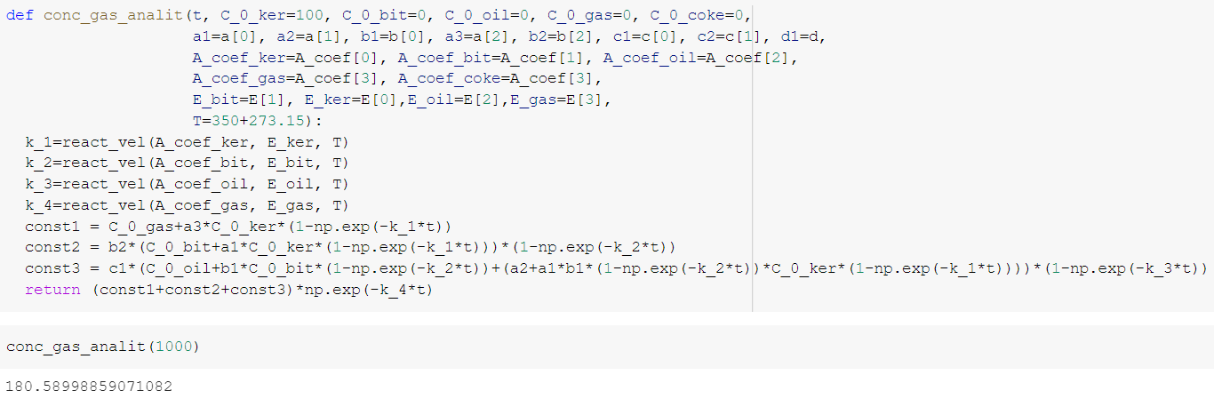
Task 1. Analytical solution for isothermal transformation of products

Slide 29
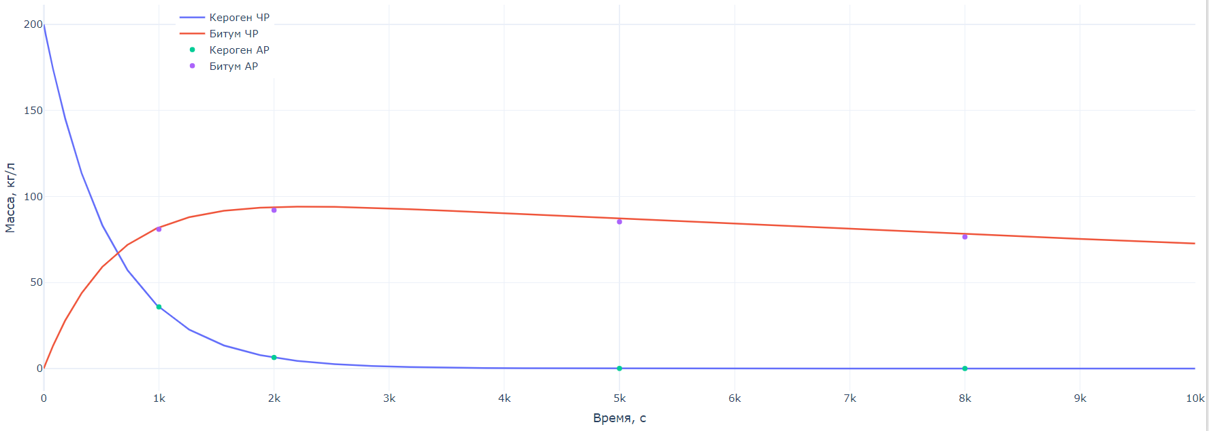
Task 2. Analytical solution for several time points

Slide 30
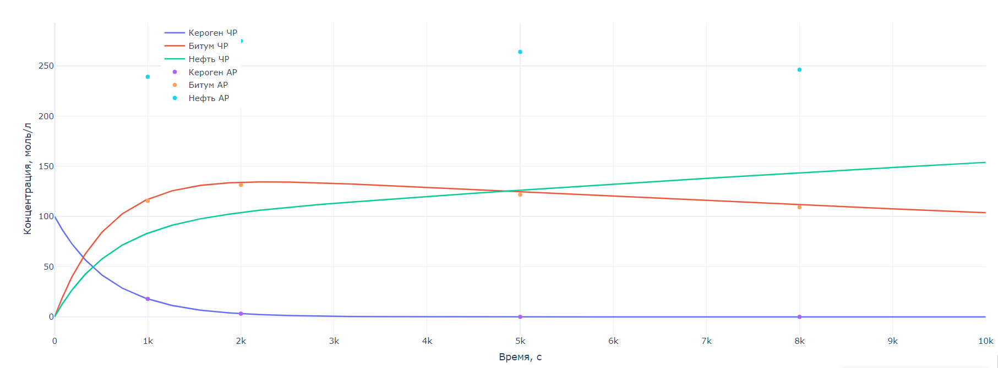
Task 2. Analytical solution for several time points

Slide 31
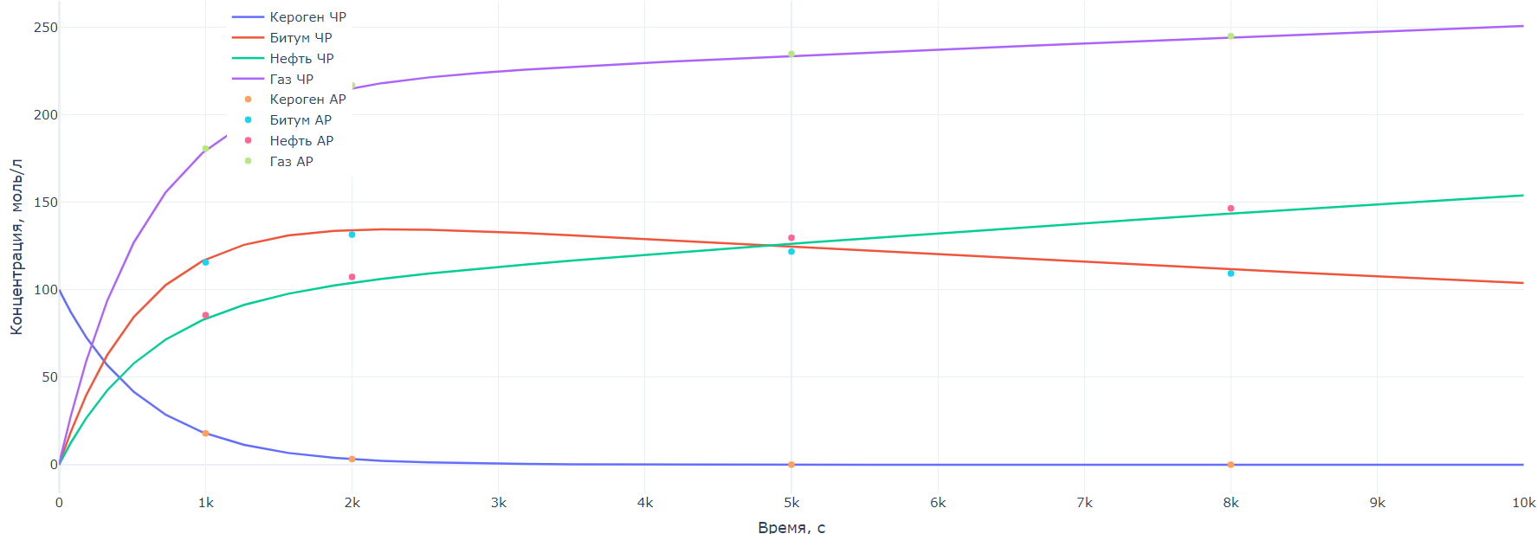
Task 2. Analytical solution for several time points

Slide 32
Task 2. Comparison with numerical results from W2

Slide 33
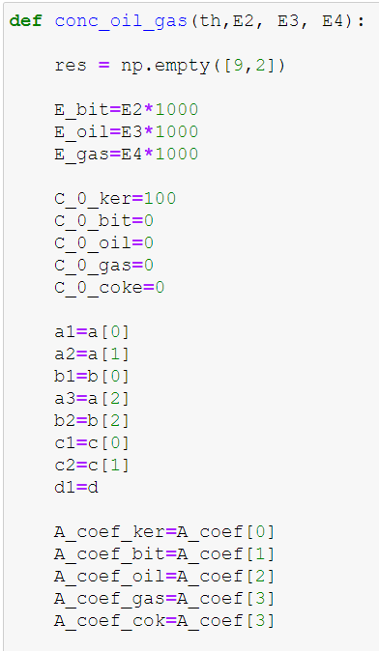
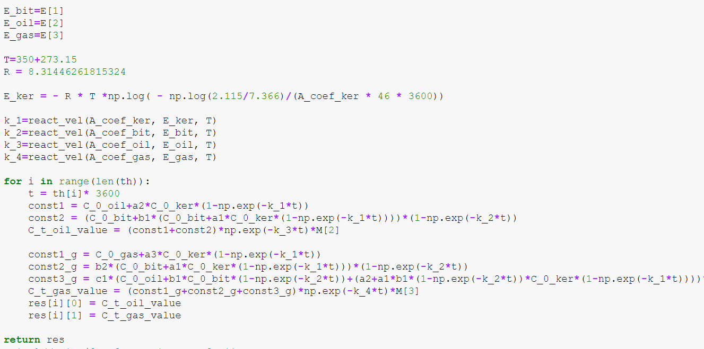
Task 3a. Nonlinear curve fitting and defining optimal activation energies

Slide 34
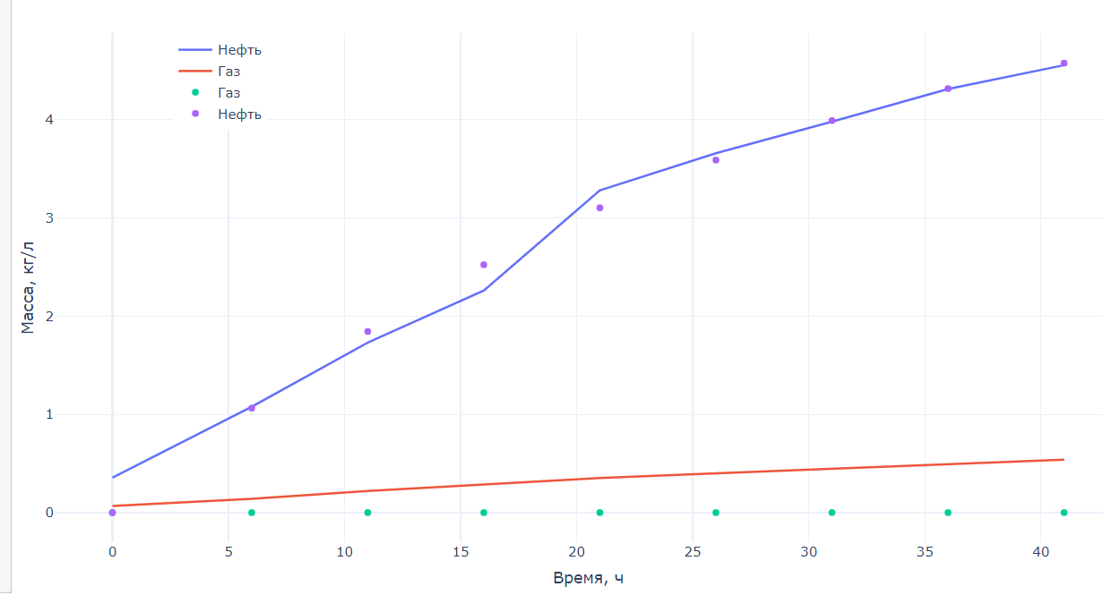
Task 3a. Nonlinear curve fitting and defining optimal activation energies

Slide 35
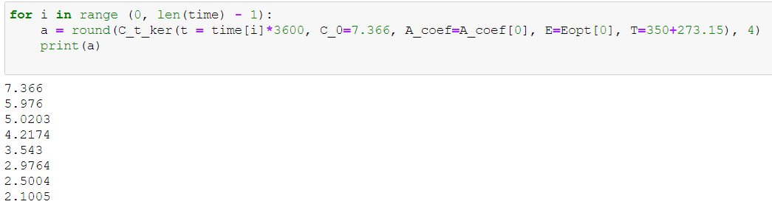
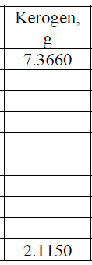
Task 3a. Nonlinear curve fitting and defining optimal activation energies

Slide 36
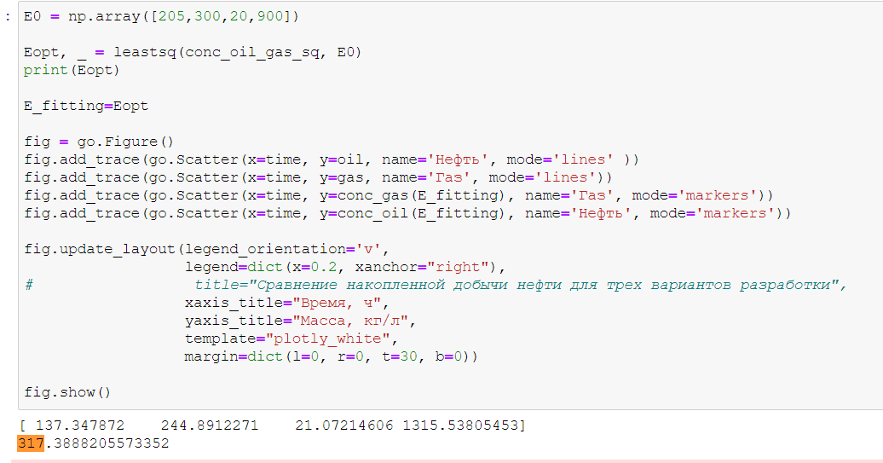
Task 3b. Nonlinear curve fitting and defining optimal temperature and frequency factors

Slide 37
Task 3b. Nonlinear curve fitting and defining optimal temperature and frequency factors

